Slide 1
Gym Rat
Marcy Bursac
@MawsayB on GitHub

Slide 2
Description
Built to give individuals more time building muscle and less time writing down notes or standing on a scale.

Slide 3
Features
LIFT – where Users can pick to Work a Plan they already created, create a workout On the Fly, or Make a Plan and plan ahead for upcoming workouts.
ANALYZE – Users quickly see their Top 5 Heaviest Weightlifting Exercises and view progress by exercise.
MEASURE – contrary to pop culture, being lean does not always who up on a scale. This feature allows Users to measure their butt, thigh and waist.

Slide 4
Planning - User Stories
Users are able to record workouts and then see the weights/sets from previous workouts to decide how heavy to lift the next time.
Users are able to see how their strength is improving on specific exercises.
Users are able to store muscle measurements throughout their healthy journey and see a report card of progress.

Slide 5
Planning - Database
Users – allows storage of credentials and activity history
Exercises – various activities a User might do
ExerciseTypes – divided into Cardio or Weightlifting so that Exercise Analyze stats focus on weightlifting exercises
Workouts – a group of exercises, determined by the User
Sets – the quantity of sets and reps a user completes in a Workout

Slide 6
Technology Stack
C#, JavaScript, CSS, HTML, LINQ
ASP.NET
SQL

Slide 7
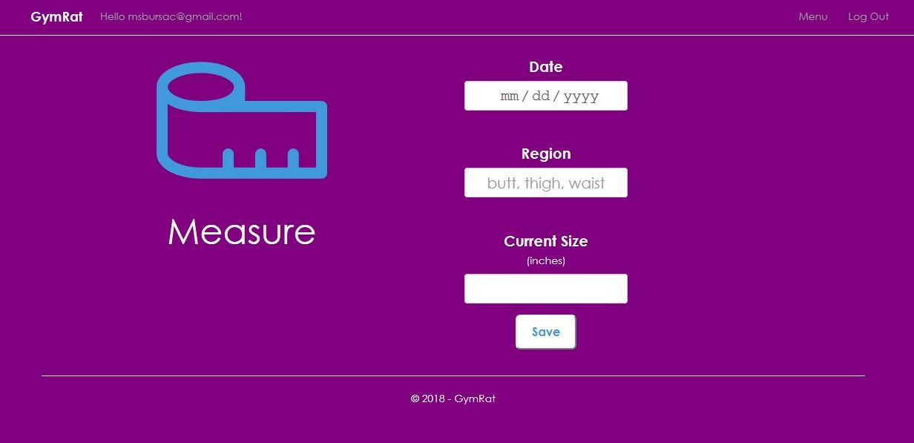
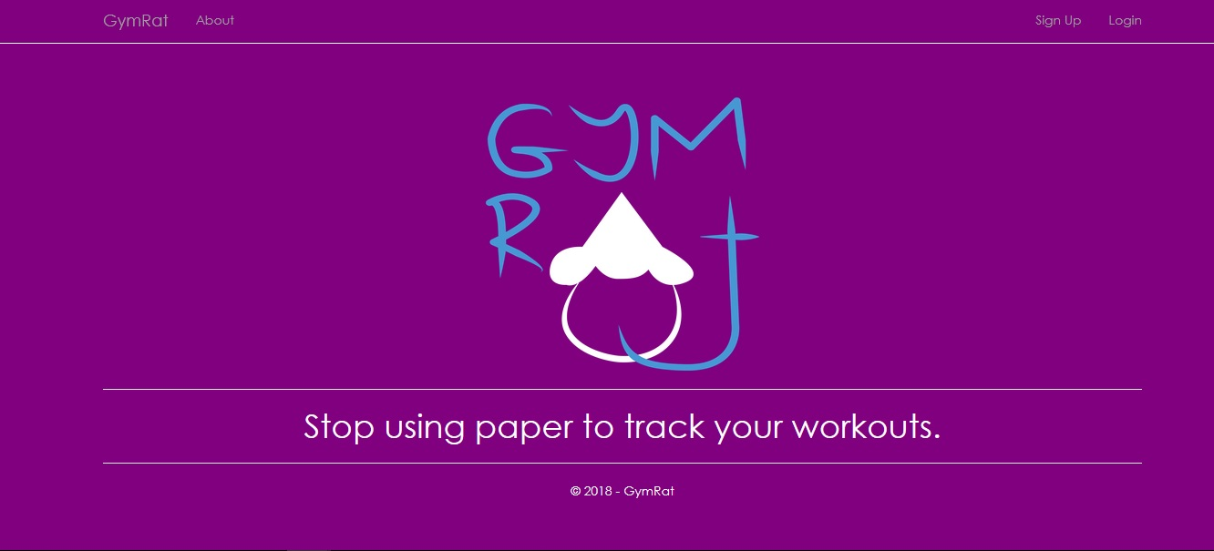
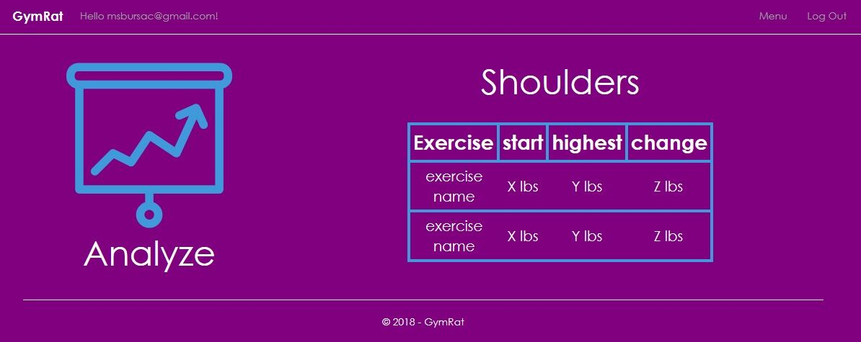
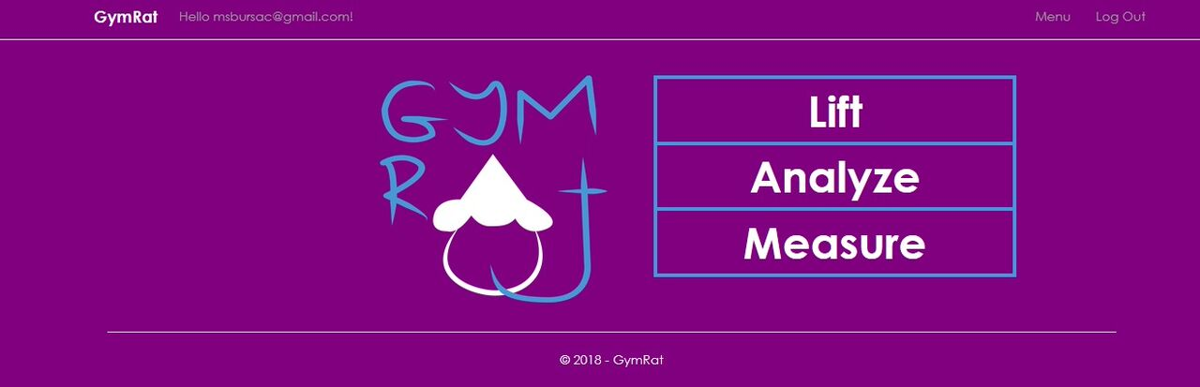
Demo

Slide 8
What I Learned
Visual Studio has a built-in sign up / login template for secure account access
JavaScript is Powerful for duplicating elements
Constant User input is critical to designing an app that meets their needs

Slide 9
What’s Next
Put the solution onto the phones and computers of Beta Testers
Business Plan
Swag
Notes:
Be specific! If you mention another feature describe why that features is necessary, or what problem it solves. If you mention changing the UI mention specific technologies, or libraries you will use to do that. If you mention a technology, or feature you don’t know yet tell them how you plan on learning it.

